Slide 1


Eric Loyd
World Conference 2025
Seriously Advanced Nagios XI Configuration

Slide 2

Introduction – About Eric
Started working on Nagios in 2004
Speaker at every Nagios World Conference since 2012
Received Nagios MVP award in 2014
Received another in 2015
Winner in the 2015 Nagios Log Server contest
COO of EverWatch Global, a Nagios Authorized partner & 100% pure-play Nagios professional services provider
IT professional, entrepreneur, musician, and astrophotographer
Nagios World Conference 2025

Slide 3

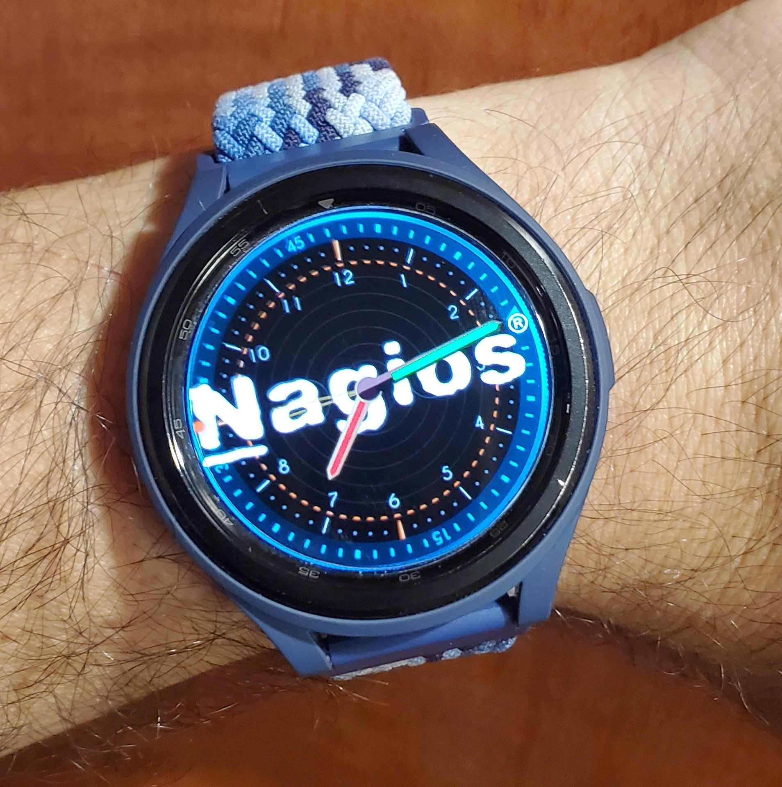

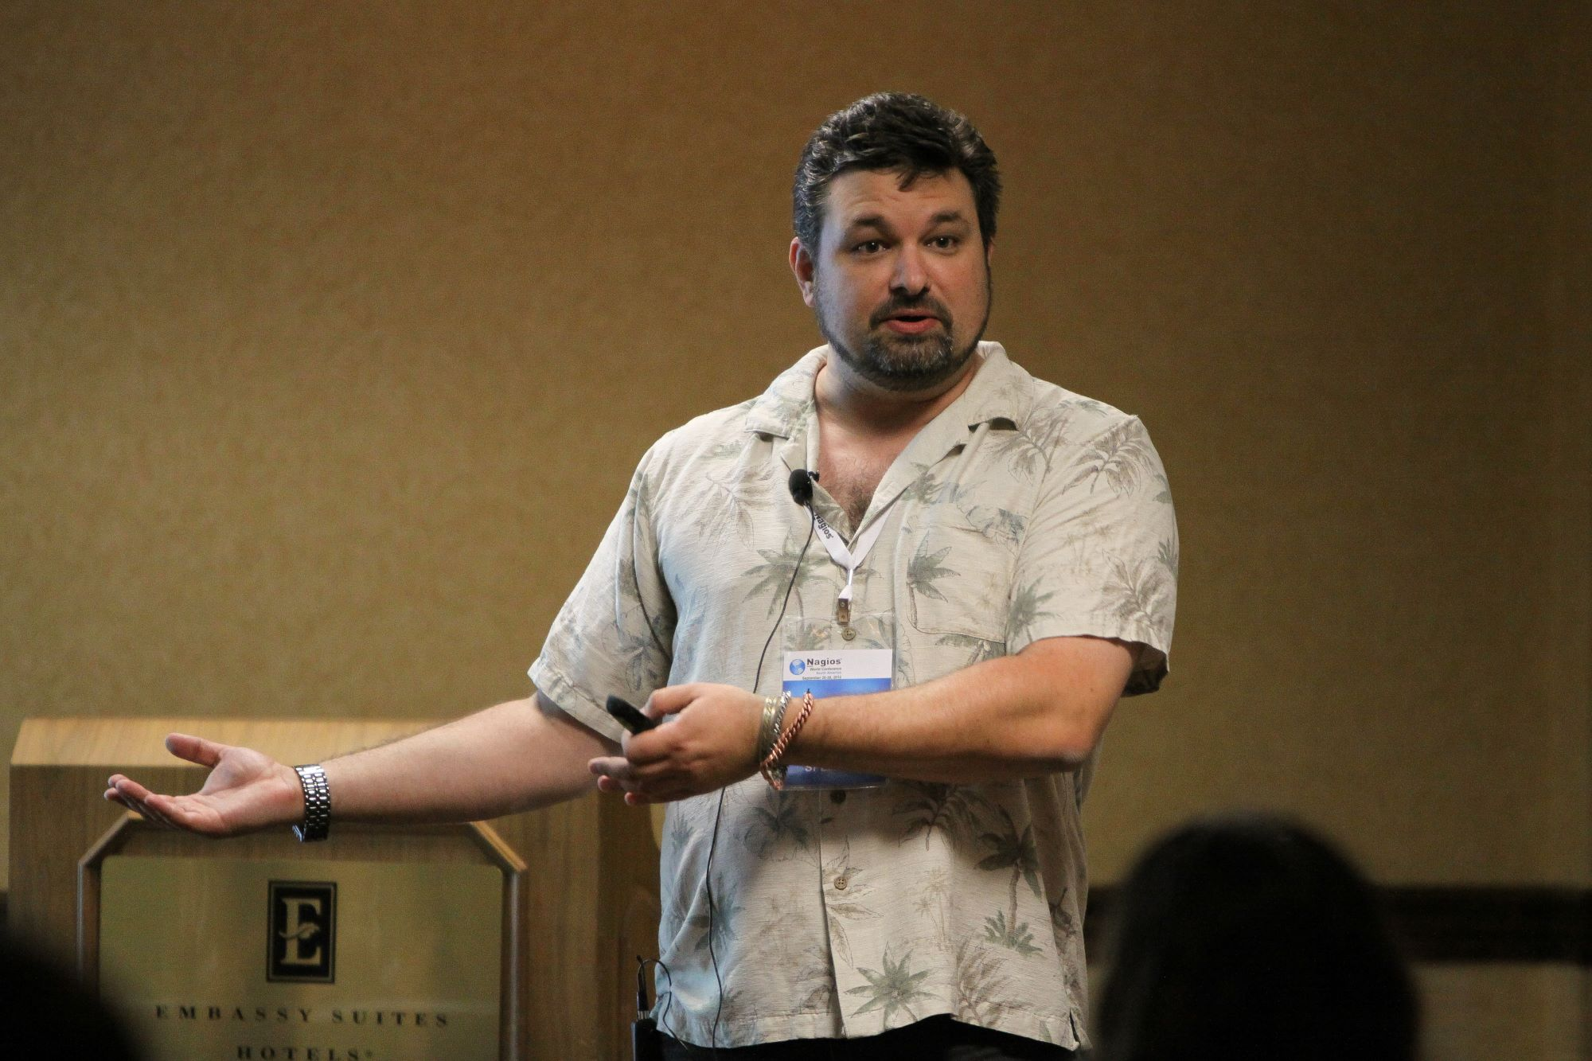

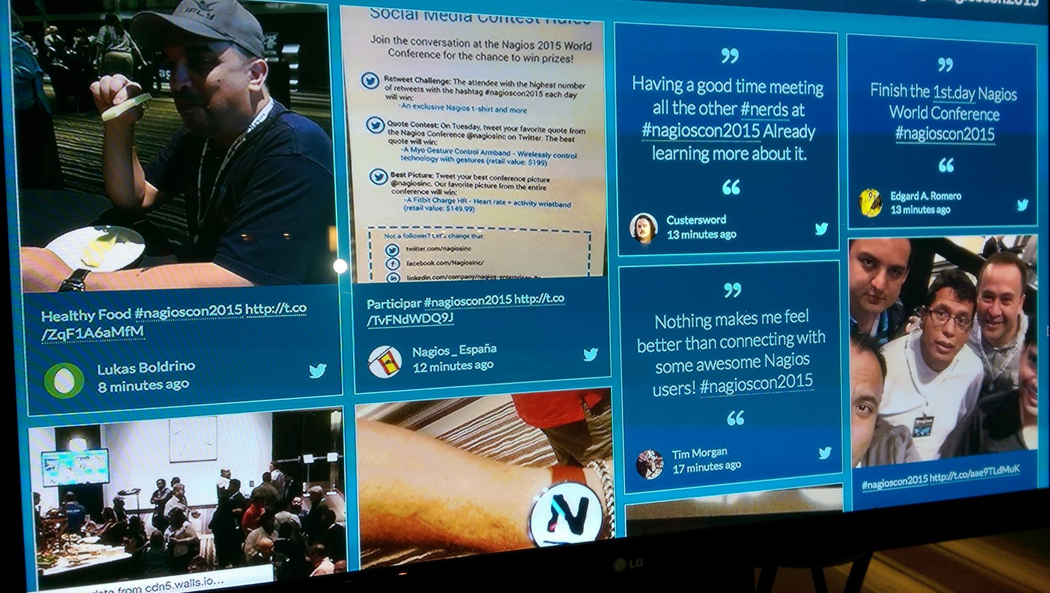



Slide 4
Agenda
A very brief overview of the Nagios XI API
“Command line” version of the GUI
Automated federation Nagios XI Core*
Self-aware Nagios XI services
*The new Nagios Mod Gearman of 2024R2.2 effectively supersedes this, but it’s still cool and can be done with all versions of XI.
Nagios World Conference 2025

Slide 5
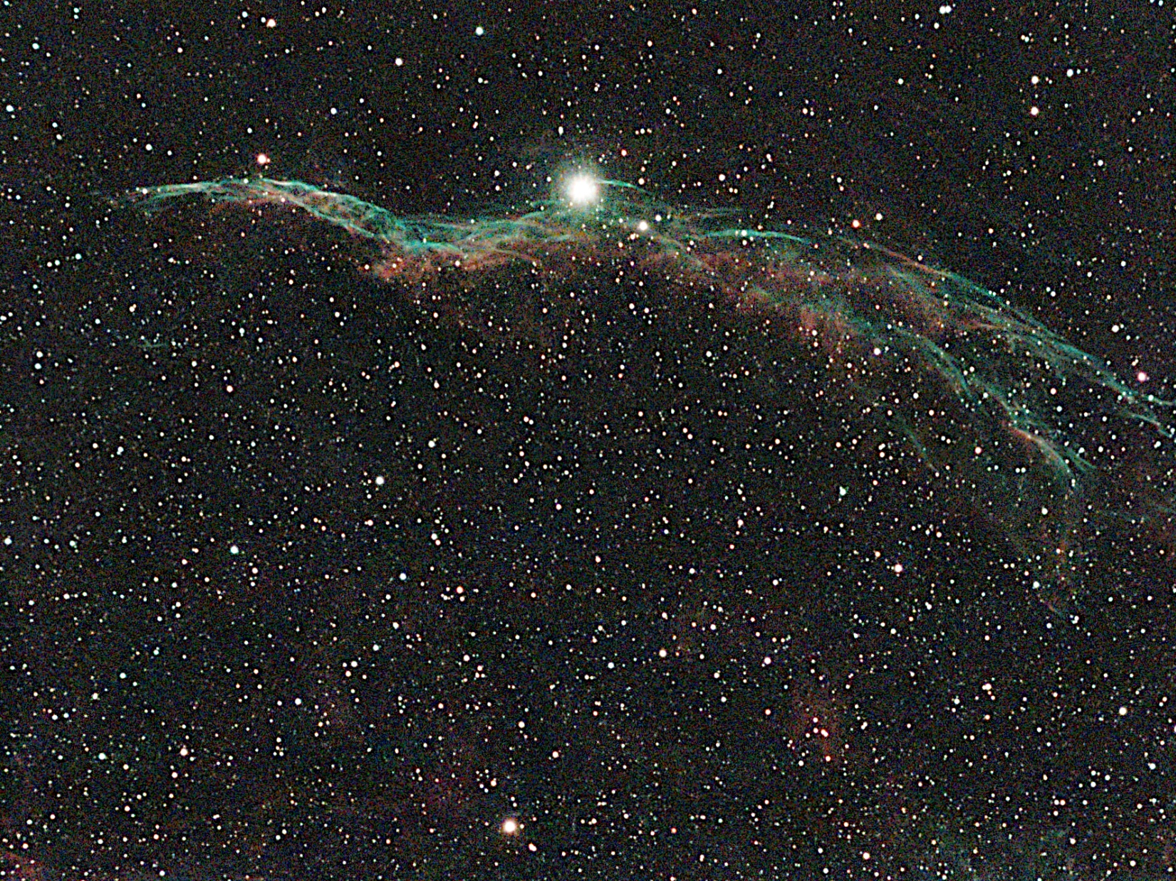
Western Veil Nebula (NGC 6960)
Nagios World Conference 2025

Slide 6
The Nagios XI API
Have you ever actually clicked on the help icon?
Nagios World Conference 2025

Slide 7
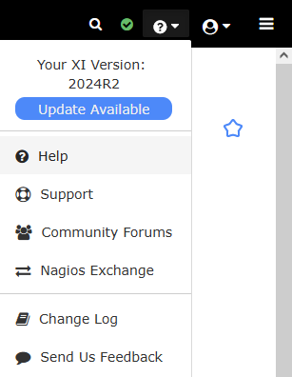
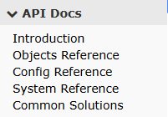
The Nagios XI API
Click on the “help” button sometime, and you’ll get documentation
The API provides full* read and write access to hosts, services, users, configuration, history, and more
You need to have API access activated for a user
And you need that user’s API key
With this, you can get all sorts of information via #!/bin/bash
*Some very esoteric things can’t be done [yet?] via the API (Aaron?)
Nagios World Conference 2025

Slide 8

North America Nebula (NGC 7000)
Nagios World Conference 2025

Slide 9
Command Line GUI
Leverage the API to get all status information over your crappy hotel hotspot (aka, text)
Nagios World Conference 2025

Slide 10
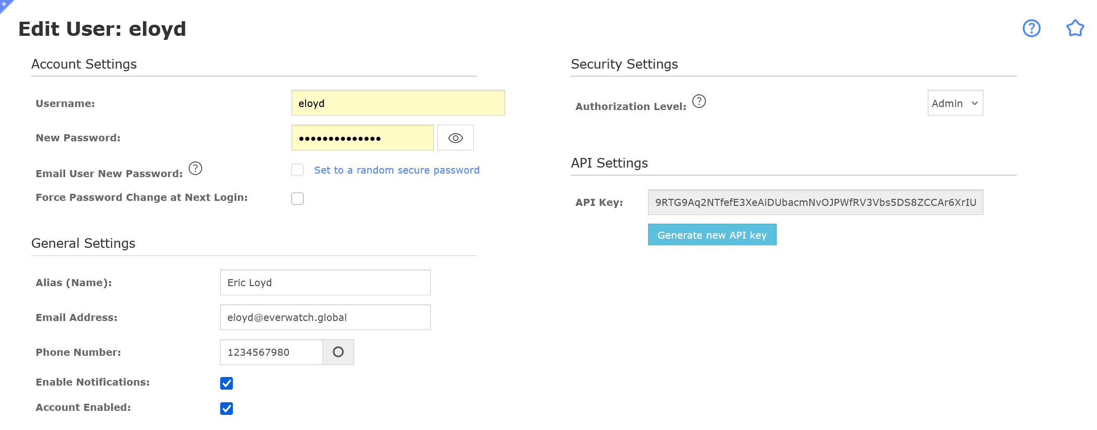
What You’ll Need
A Nagios user with at least read access to everything
API access activated for that user
That user’s API key
Some services to show up in the output
Some software installed on your client box (not the XI server):
curl
jq
csvtool (optional)
Nagios World Conference 2025

Slide 11
Let’s get a Command Line GUI
Execute the API via CURL to get current service status as JSON data
Parse that data with JQ to get what we want
Optionally, only show the bad stuff
Convert to CSV
Parse with CSVTOOL (optional)
Display in our SSH session
Easy peasy, lemon squeezy
cron it all into an email and send to the IT Director every 30 seconds
Nagios World Conference 2025

Slide 12
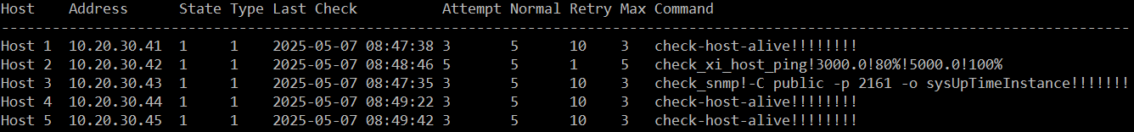
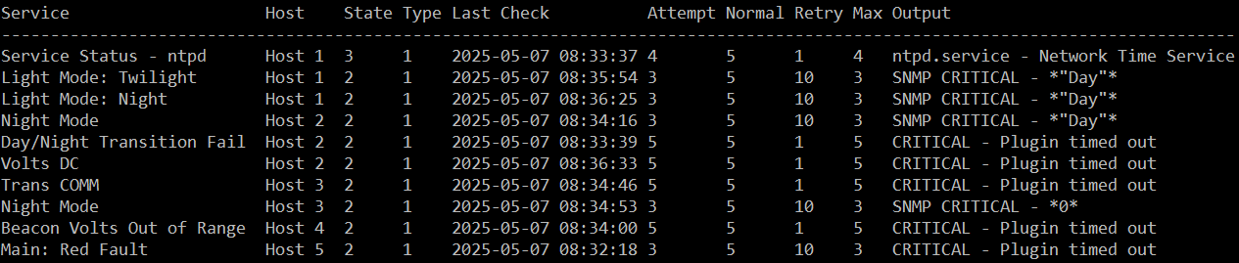
Sample Output
Nagios World Conference 2025

Slide 13

Whirpool Galaxy (M 51)
Nagios World Conference 2025

Slide 14


Automated Federation
For when it absolutely, positively, must be done without human intervention at all hours of the day and night
Nagios World Conference 2025

Slide 15
What You’ll Need
A Nagios XI server with your hosts and services configured passively
Decent knowledge of the Nagios XI API
Some hosts in hostgroups (SITE_ONE, SITE_TWO etc)
A host template to create a Nagios Core hosts.cfg file [optional]
A service template to create a Nagios Core services.cfg file [optional]
Some software on your Nagios Core (client) box:
curl
jq
Nagios World Conference 2025

Slide 16
Let’s Automate Some Stuff
Nagios Core box at XXX calls API to get hosts in SITE_XXX hostgroup
Loop through the results and for each host, pull config information for that host from the API and use JQ to reproduce the data structure as a valid “define host {…}” hosts.cfg configuration stanza (whew!)
Pull service status information from API
Grab entries that are on hosts that match SITE_XXX members
Pull appropriate fields (service_description, check_interval, etc) and create valid “define service {…}” services.cfg stanzas (double whew!)
Repeat for SITE_YYY, etc.
Reload your Nagios Core and send stuff back to Nagios XI via NRDP
Nagios World Conference 2025

Slide 17

Elephant Trunk Nebula (IC 1396A)
Nagios World Conference 2025

Slide 18

Self-Aware Services
$$($USER1$/magic happens here)
Nagios World Conference 2025

Slide 19
What You’ll Need
Either:
A narcissistic, megalomaniacal desire to make things as difficult as possible for the next person who comes along and has to read your Nagios configuration after you and your Federated Bots move to Aruba
Or:
A zen state of mind that clears all obstacles from having service_description fields capable of dictating what the check_command actually does
Make one change (or add) to /usr/local/nagios/etc/nagios.cfg:
enable_environment_macros=1
The magic of shell substitution and the headache of dollar signs
Nagios World Conference 2025

Slide 20
Let’s Obfuscate Some Stuff
I used XI so this was all done in CCM but you can do this in Core as well
Create a custom plugin that will parse $NAGIOS__varName env vars
I called mine ENV and it has very convoluted parameter processing
Create a service template called “Check Disk: disk warn crit”
Use it to create a service called “Disk Usage on /home 80 90”
Set your check_command to be something like (this will be ugly):
check_xi_ncpa!-t $$($USER1$/ENV -NT) -P $$($USER1$/ENV -NP) -M "disk/logical/$$($USER1$/ENV -F 1 -p)" -w $$($USER1$/ENV -F 2) -c $$($USER1$/ENV -F 3)!$ARG8$
Nagios World Conference 2025

Slide 21
Let’s Unpack This Amazing check_xi_ncpa command
check_xi_ncpa!-t $$($USER1$/ENV -NT) -P $$($USER1$/ENV -NP) -M "disk/logical/$$($USER1$/ENV -F 1 -p)" -w $$($USER1$/ENV -F 2) -c $$($USER1$/ENV -F 3)!$ARG8$
-t $$($USER1$/ENV -NT) Looks for NAGIOS__HOSTNCPATOKEN custom host macro (no default, will break, as written, if not defined)
-P $$($USER1$/ENV -NP) Looks for a NAGIOS__HOSTNCPAPORT custom host macro (defaults to 5693 if not found)
-M “disk/logical/$$($USER1$/ENV -F 1 -p)” Looks at the first of the last three fields separated by spaces (/home) [Design choice when making ENV]
-w $$($USER1$/ENV -F 2) Second of the last three fields (80)
-c $$($USER1$/ENV -F 3) Third of the last three fields (90)
$ARG8$ So we can append something to the end to override whatever came before it (say, “-w 50” to change warning to 50%); take advantage of shell arg processing overides
Macro names were design choices when creating “ENV”
Parameter processing logic was also a design choice base on typical usage: Name: Thing Warn Crit
You design your version of “ENV” with whatever makes sense for you.
Nagios World Conference 2025

Slide 22
Things to Watch Out For
Beware of crazy people with API access
Watch your audit log if you start handing out API keys
If you’re doing Automated Federation via API calls this way, you’ll need a “flatter” configuration approach; no multi-layer inheritance templates, no hostgroups that include hostgroups, etc. The simpler, the better.
Remember: The goal is to distribute processing not simplify configuration
If you are going to use self-aware services, then I beg of you, please use service templates. Otherwise you’ll spend way more time making your self-aware service_descriptions and check_commands than you need to.
Also, seek professional mental health counselling. Think of the children.
Nagios World Conference 2025

Slide 23

Thank You
Eric Loyd eloyd@everwatch.global https://github.com/everwatch https://astropotamus.com
Nagios World Conference 2025

Slide 24

Download My Astro Images
Nagios World Conference 2025

Slide 25

Q&A Session
Eric Loyd eloyd@everwatch.global https://github.com/everwatch https://astropotamus.com
Northern Lights, October 2024
Nagios World Conference 2025

